Slide 1
ENSE 470, Milestone 2
DCC
Dakota Fisher, Chengyu Lou, Connor Meredith
January 25, 2018

Slide 2
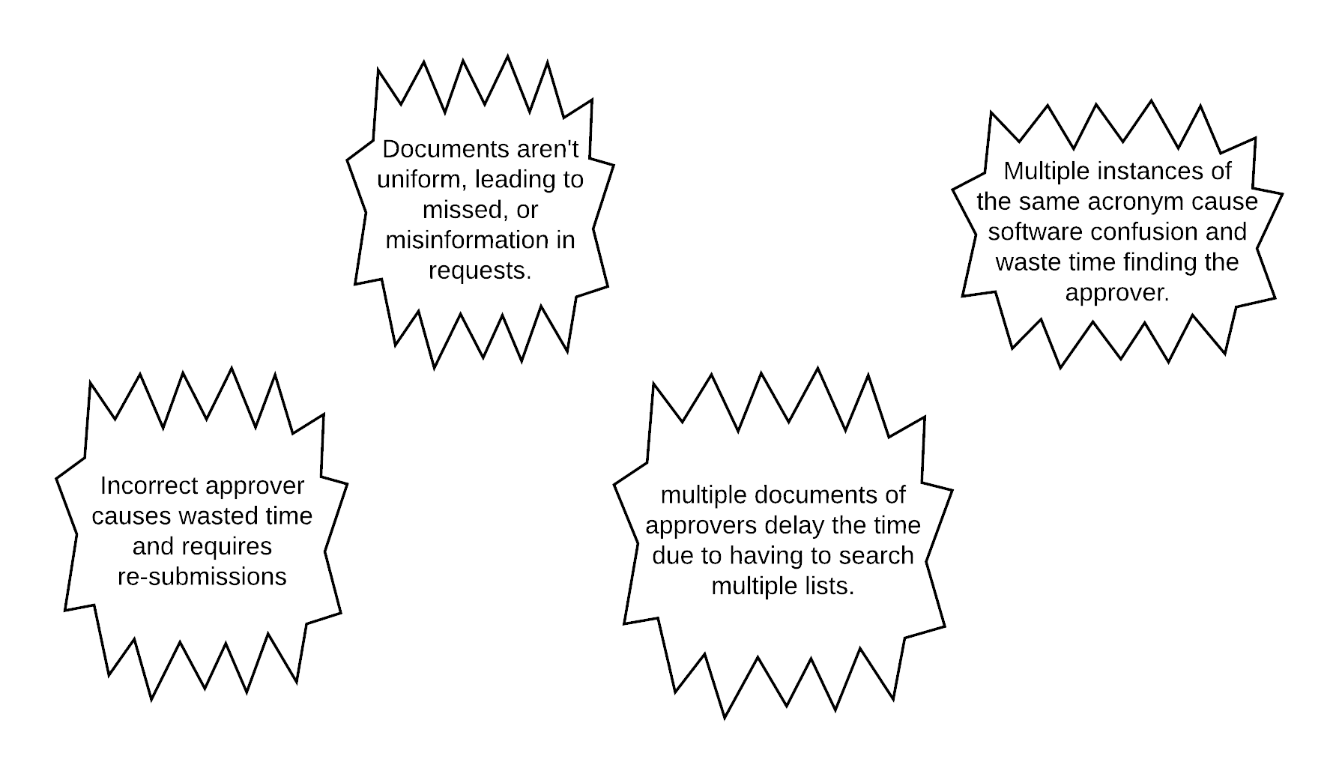
Recall, Kaizen Bursts

Slide 3
Idea sheets
Describe your idea sheets and any categories/themes that emerged
Theme 1: Idea Cards 1 and 2
Eliminating waste
Theme 2: Idea Cards 3 and 4
Improved Flow

Slide 4
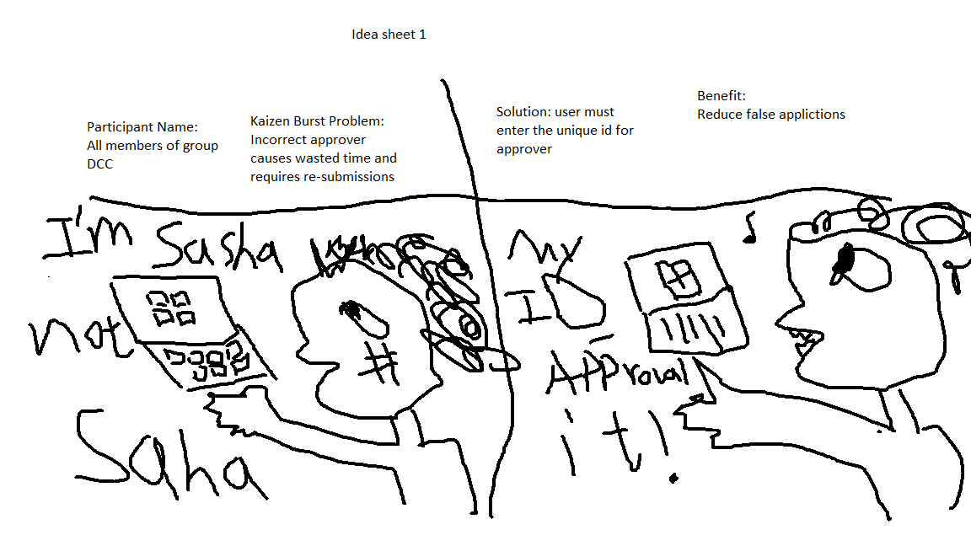

Slide 5
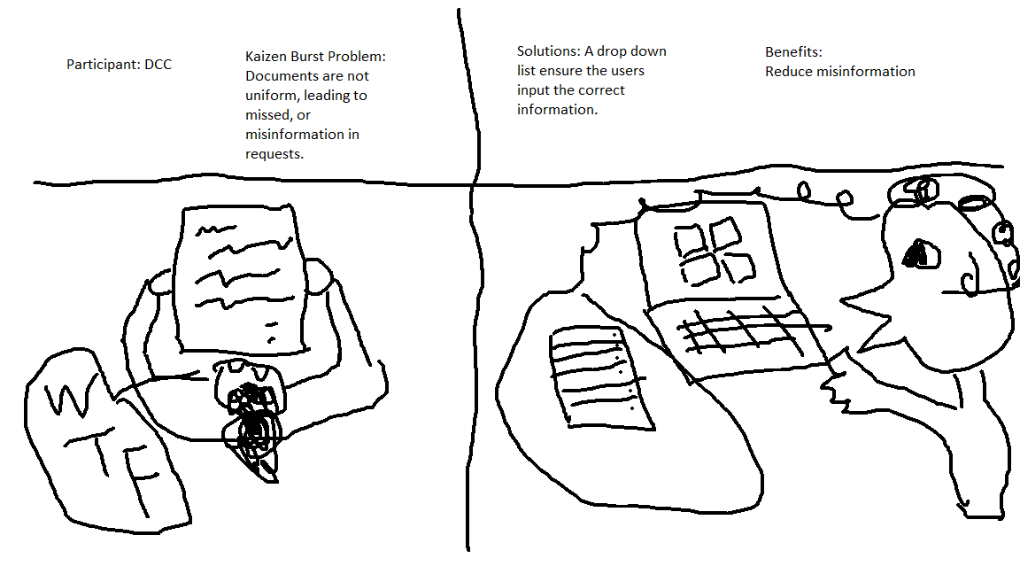

Slide 6
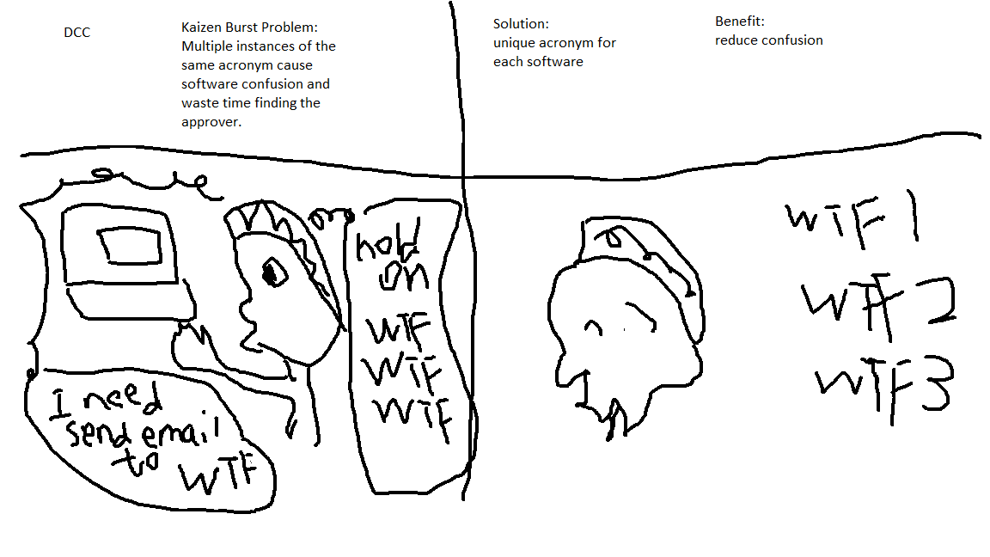

Slide 7
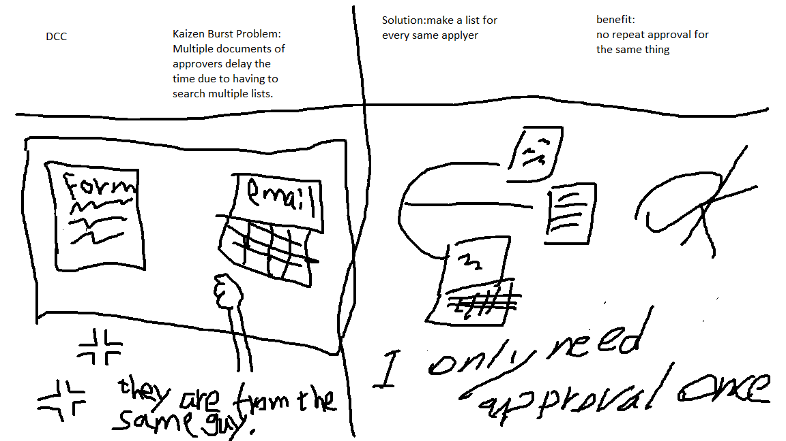

Slide 8
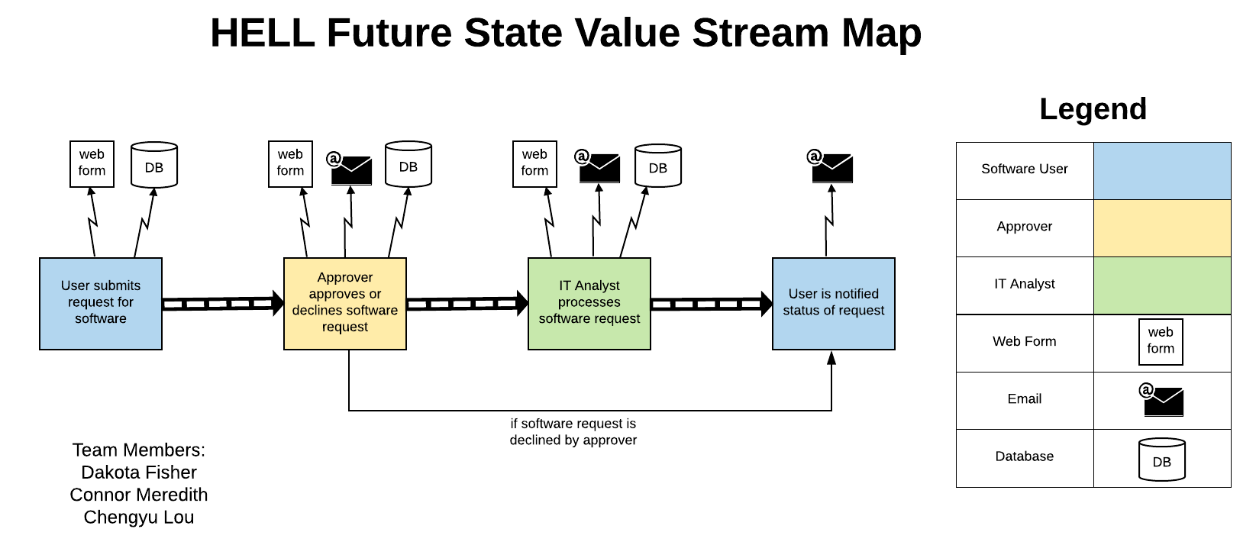

Slide 9
Group reflection
How did you feel about this milestone? What did you like about it? What did you dislike?
Likes
Reinforced the use of the VSM
Almost a roadmap for the project
Not set in stone, able to adapt plan in the future
Dislikes
Not a whole lot, fairly straight forwards.

Slide 10
Group reflection
What did you learn about yourself as you collaborated and worked through this milestone?
It’s easy to try to do too much work.
Learn to better delegate work between ourselves.
How will you use what you have learned going forward?
We will utilize the almost third person perspective to adapt future solutions.
What “stuff & things” related to this milestone would you want help with?
Nothing really, it mostly extended the previous milestone.

